Slide 1
अA
BAIF Translator
Tech for Good Hackathon
Text · Audio · Video translation across Marathi, Hindi, and English — fully offline, zero-cost, on BAIF's own hardware
Team : GPE Warriors

Slide 2
Problem Statement
Objective
Develop a scalable, offline-capable web application that translates text, audio, and video between Marathi, Hindi, and English, enabling BAIF field staff to communicate effectively without internet connectivity.
Scope
• Accept Text, Audio, and Video inputs
• Speech-to-Text for audio/video
• Translate: Marathi ↔ Hindi ↔ English
• Generate translated text
• Generate translated speech (TTS)
• Create subtitles (SRT/VTT/Burned-in)
Requirements
✓ Video: MP4, MOV, AVI, WMV, MKV, FLV, WebM
✓ Audio: MP3, WAV, AAC, M4A, FLAC, WMA, OGG
✓ Fully Offline Operation
✓ Open-Source Technologies Only
✓ Deployable On-Premises
✓ No Cloud / HSBC Dependencies
✓ No Licensing or Usage Costs

Slide 3
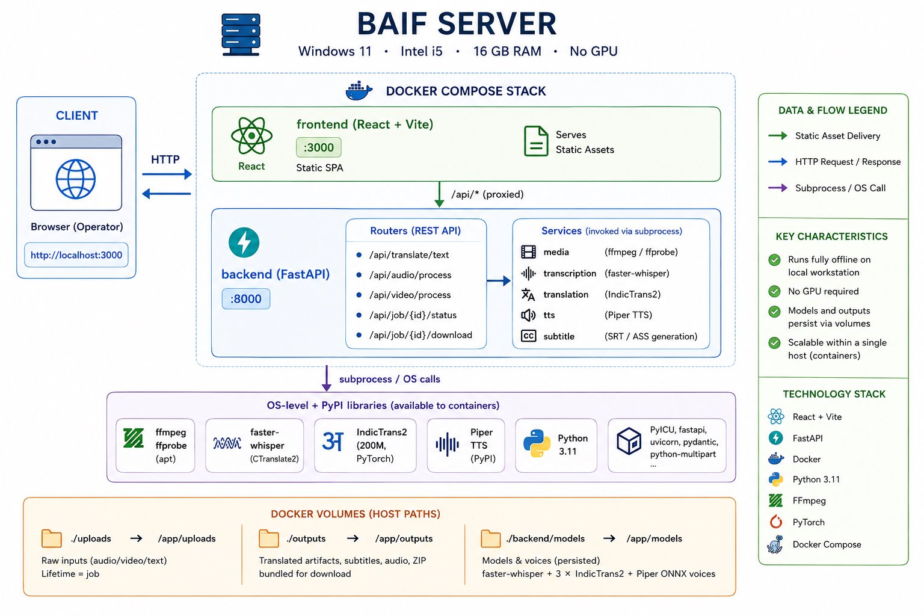
Solution Architecture

Slide 4
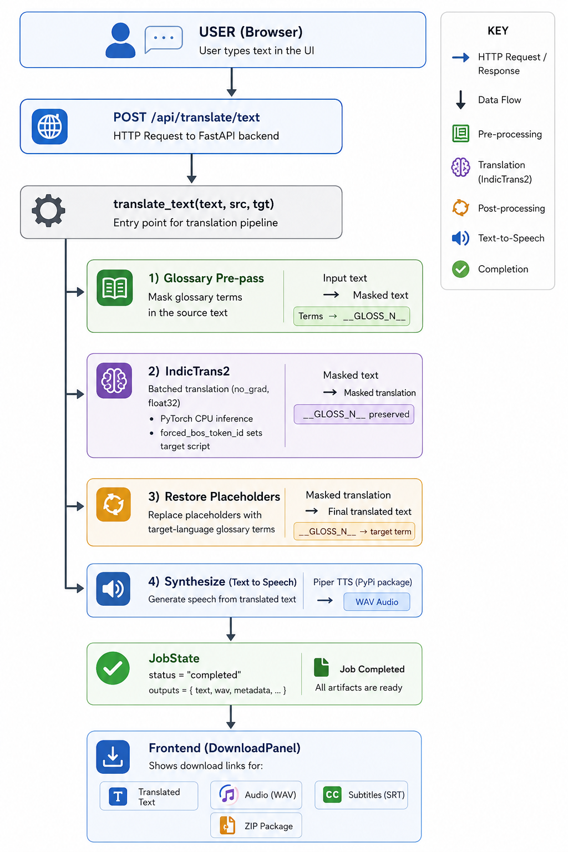
Flow Diagram

Slide 5
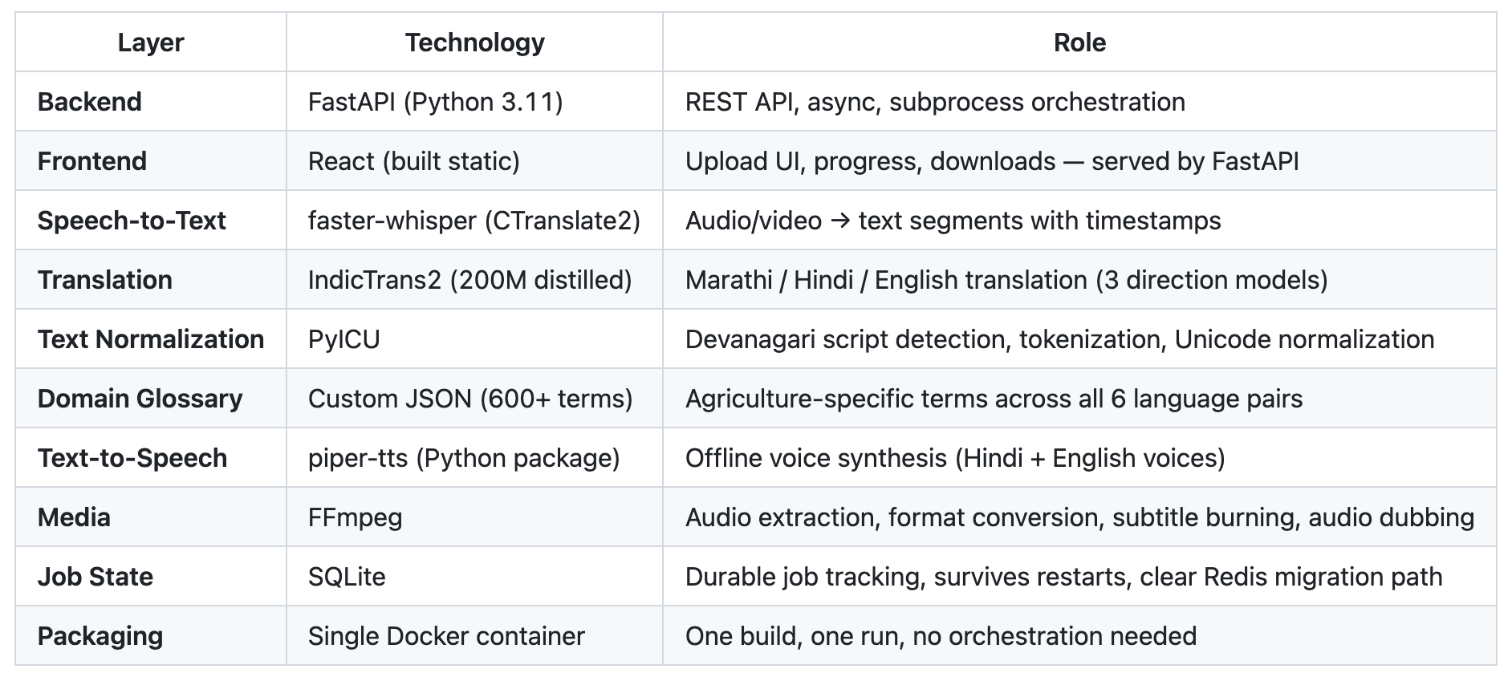
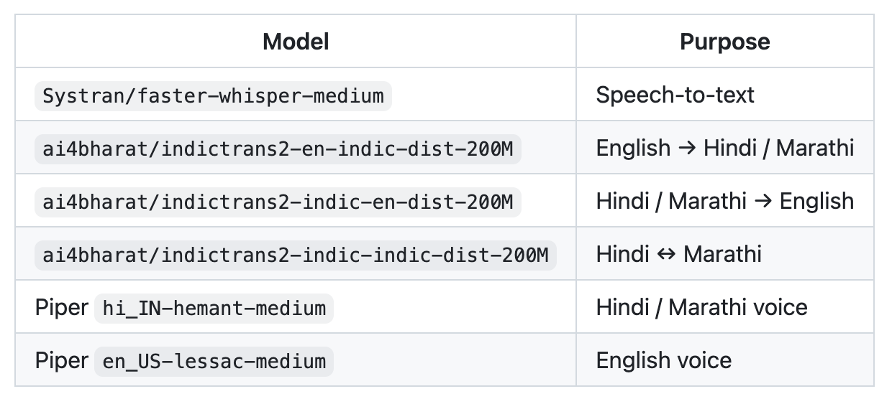
Tech Stack
Transformer models for translation

Slide 6
Addressing the Evaluation Pillars
1. Impact
Removes the translation bottleneck for field teams working across Marathi, Hindi, and English.
2. Scalability & Production Readiness
Dockerized microservices (frontend, backend, media, ASR, translation, TTS) — each layer scales independently.
3. Usability & User Experience
Single web UI for text, audio, and video uploads with job status and downloadable outputs.
4. Tech Safety, Fairness & Inclusivity
All processing stays on BAIF’s own hardware — no field data ever leaves the premises. No API call.
5. Cost
100% open-source components (Whisper, Apertium, Piper, FFmpeg) — zero licensing or usage cost.

Slide 7
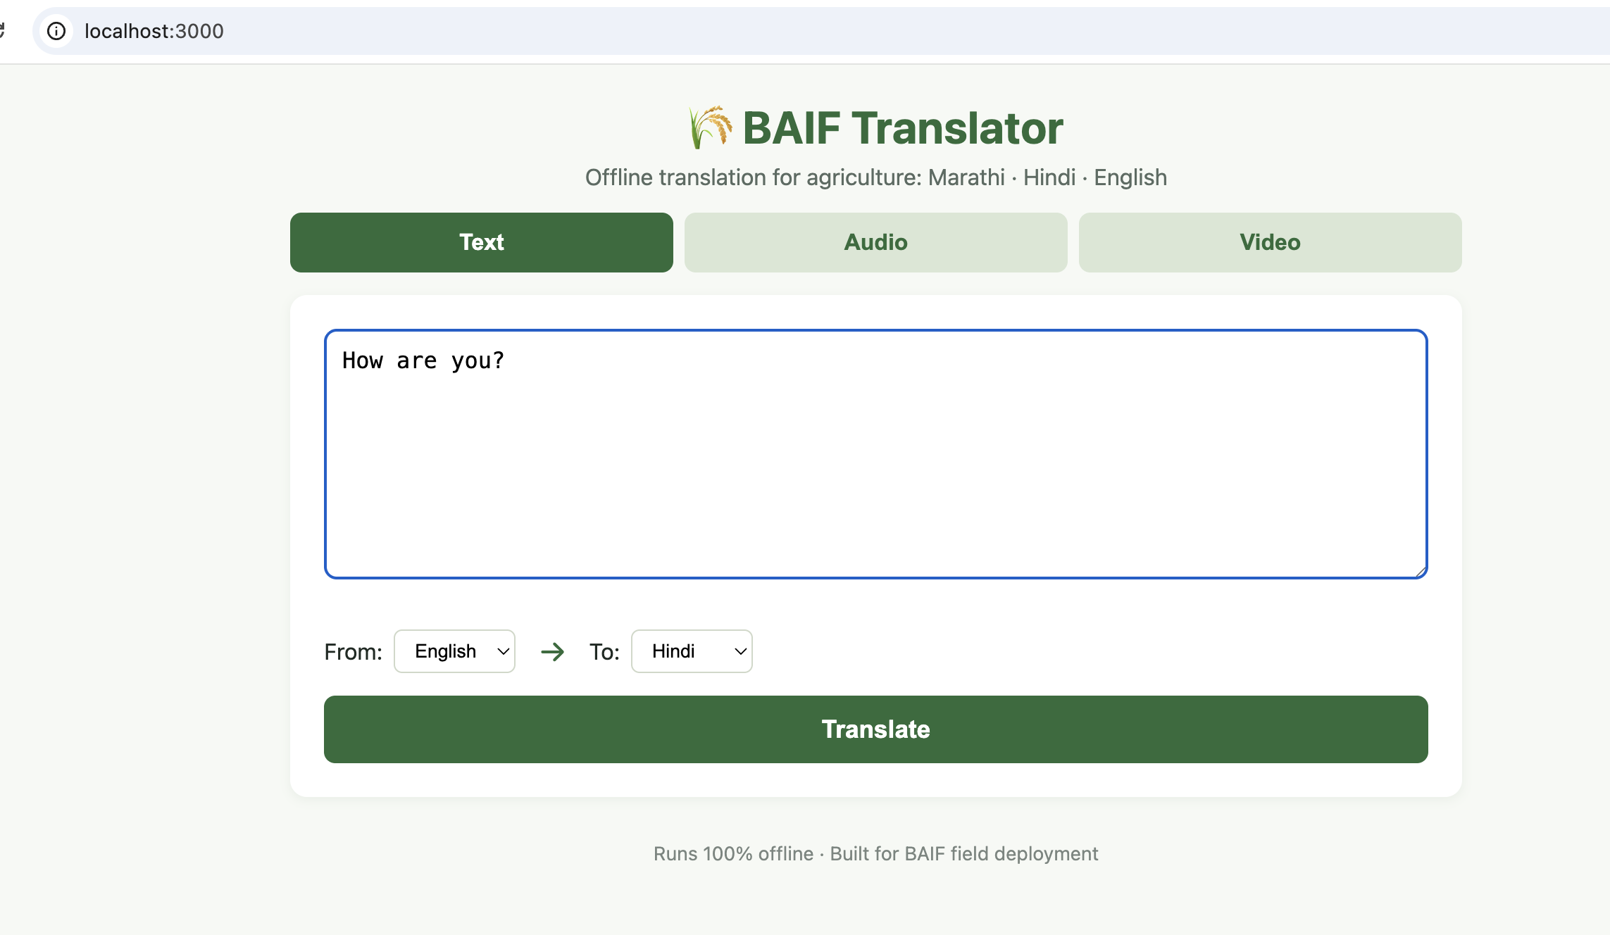
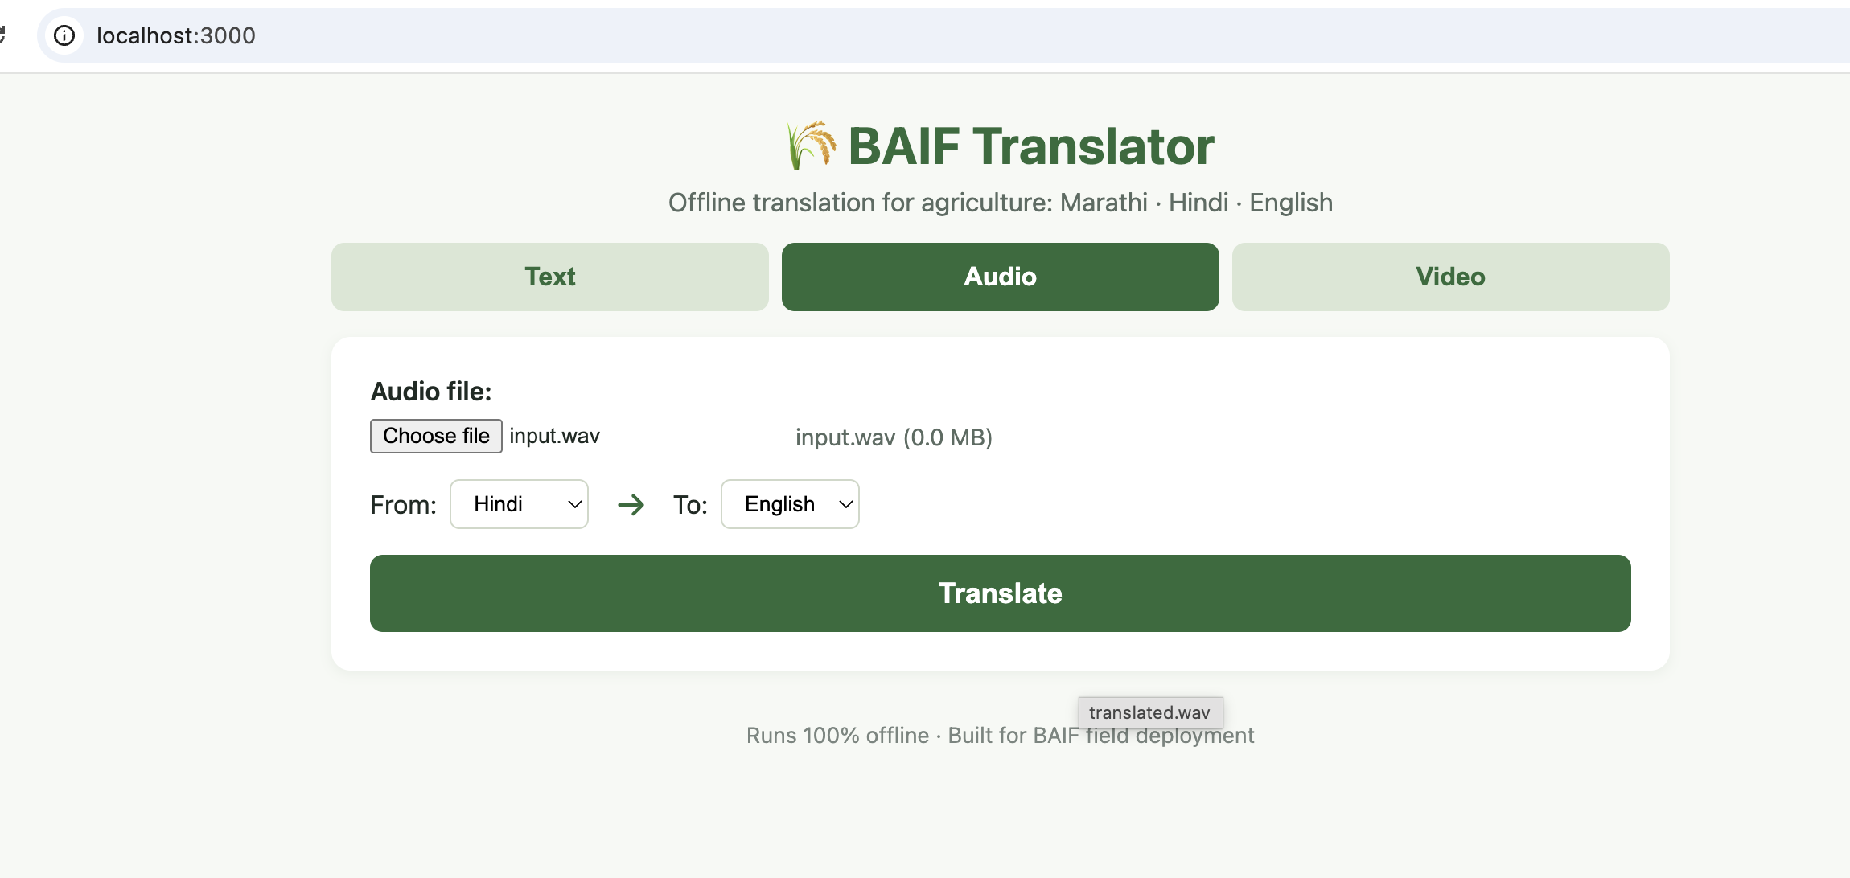
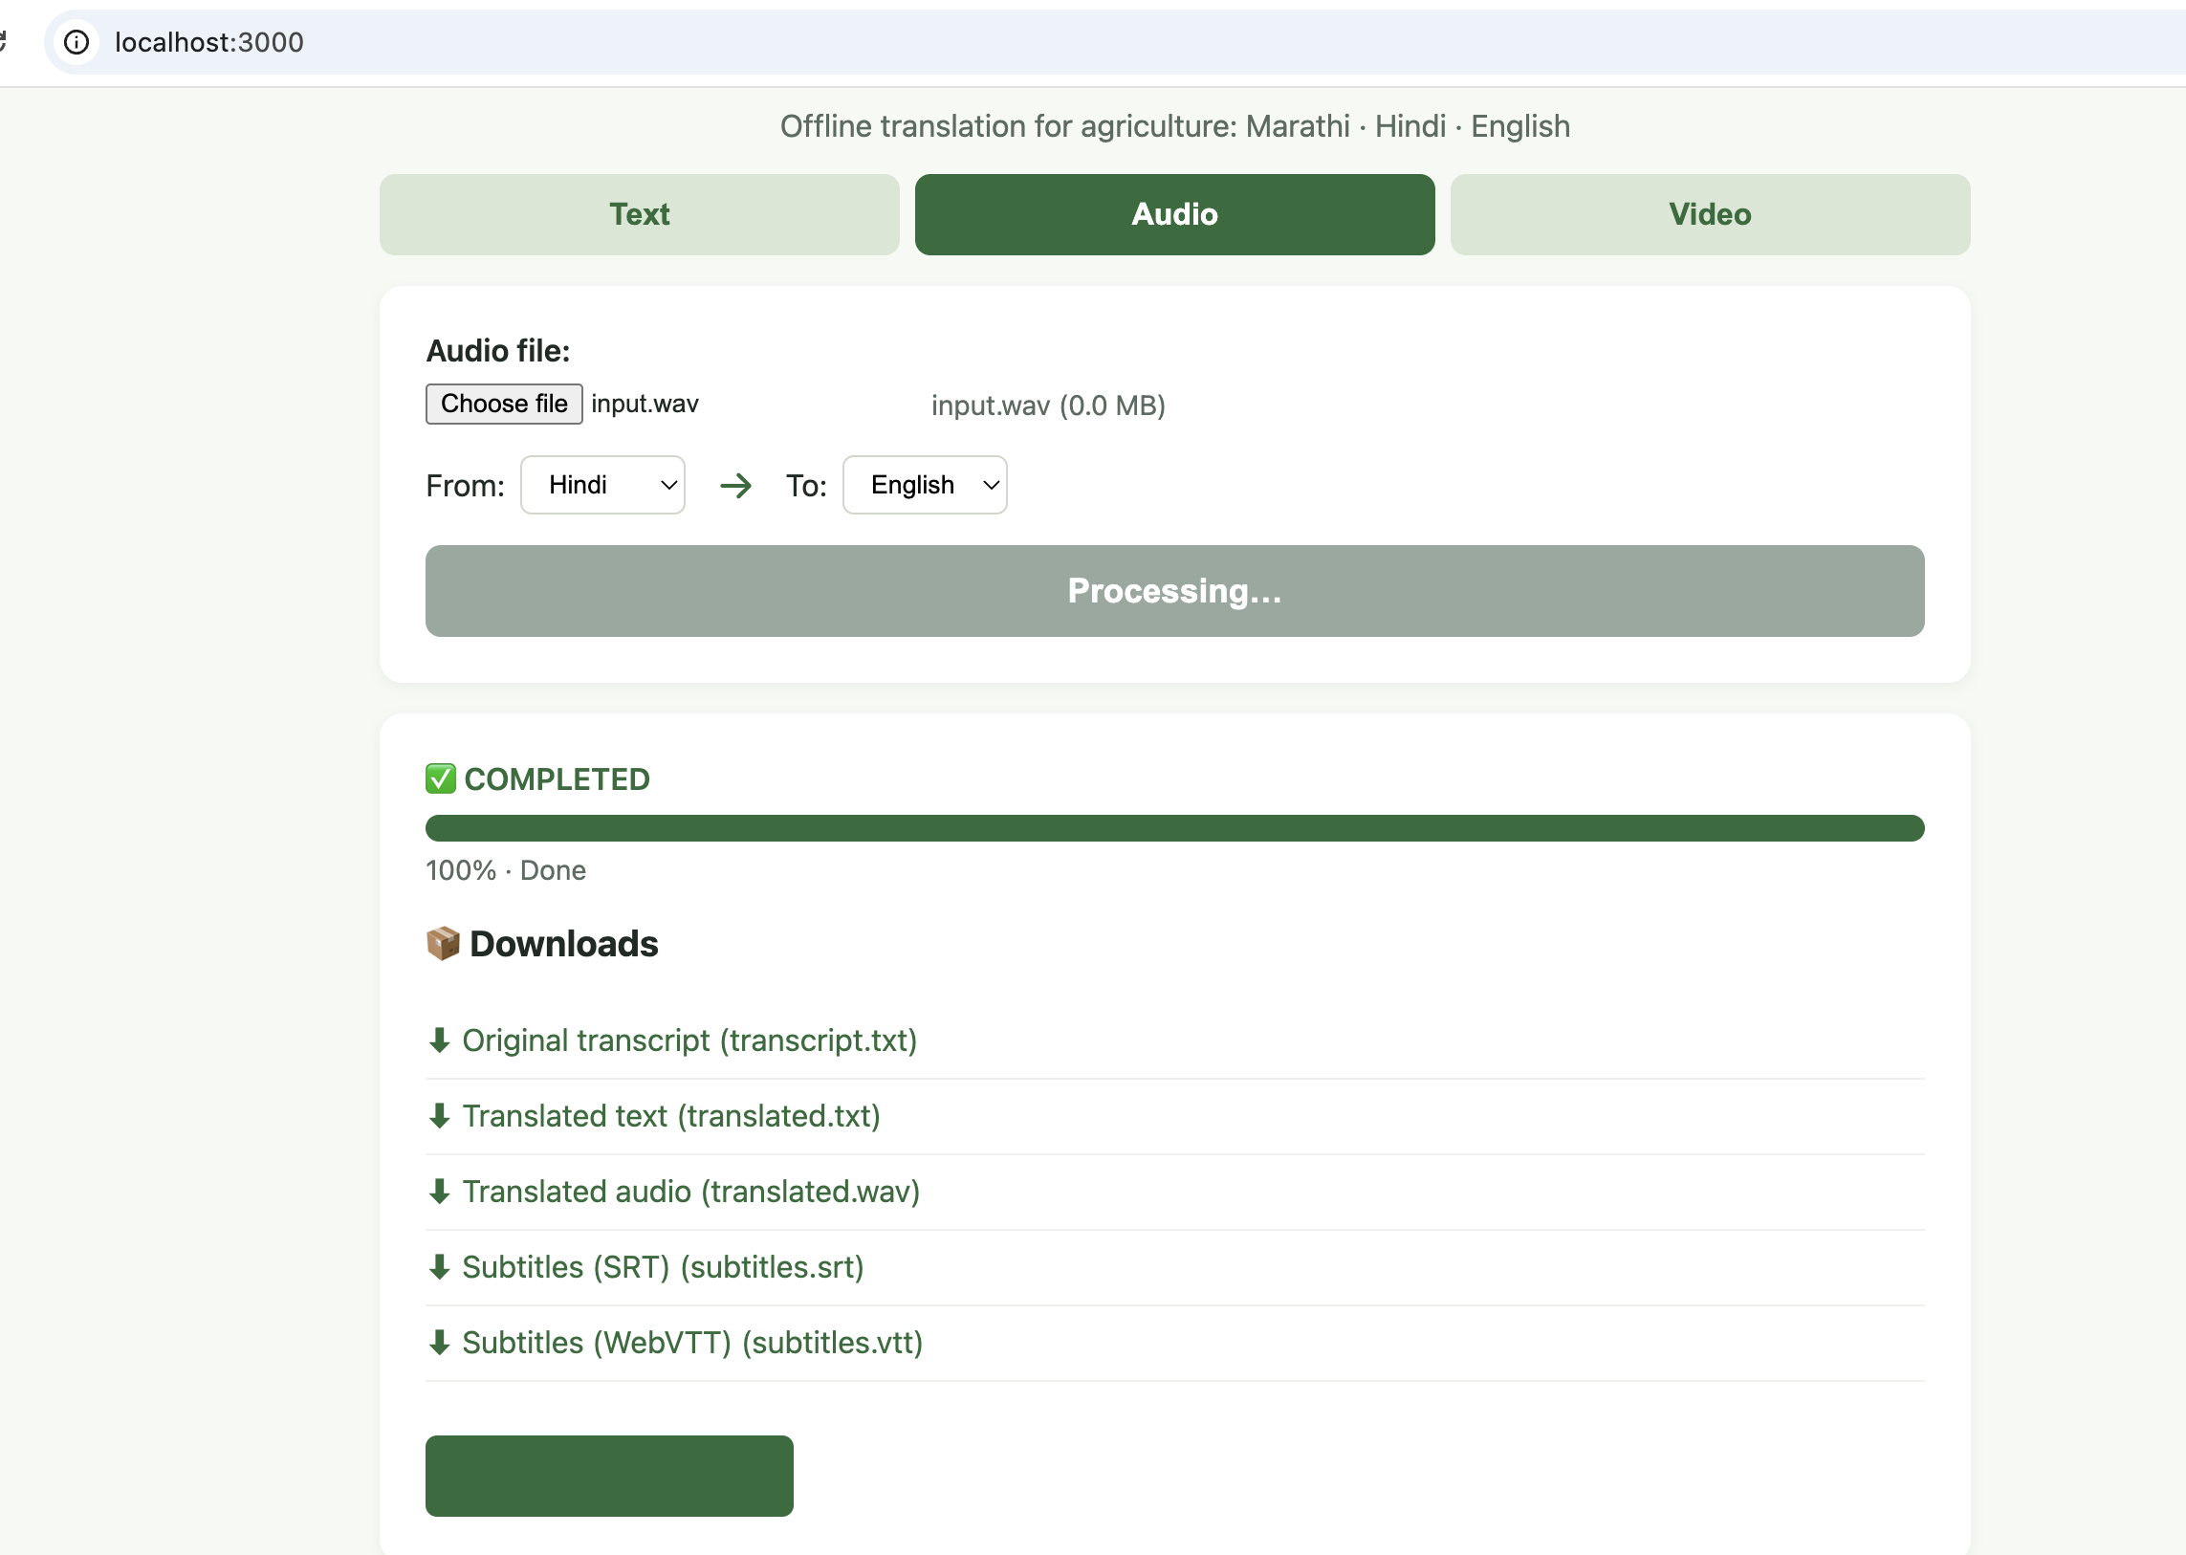
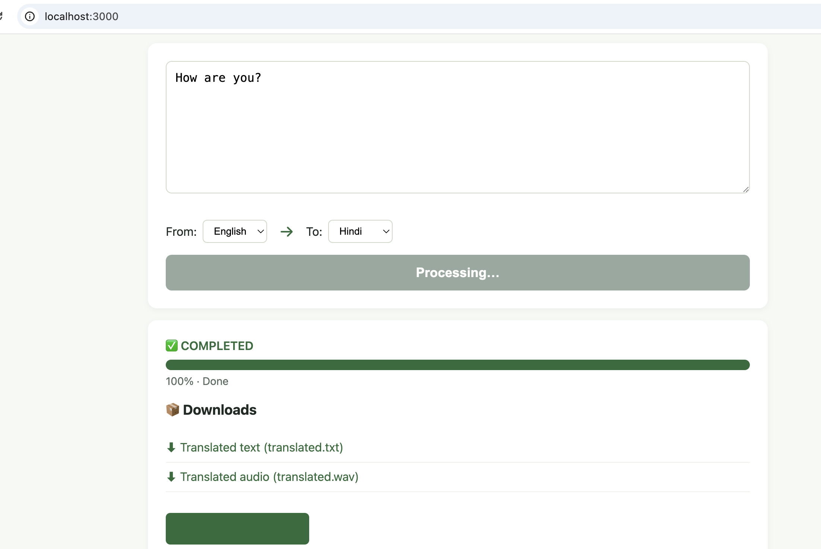

Test Evidence
Text
Audio
Input
Output

